Slide 1




Introduction to Causal Inference for Software Engineering
A 90-minute hands-on tutorial
Julien Siebert · Julian Frattini · Hans-Martin Heyn · Roberto Pietrantuono

Slide 2
Section 4
Exercises: Identification, adjustment sets and conditional independence
Exercises
2

Slide 3
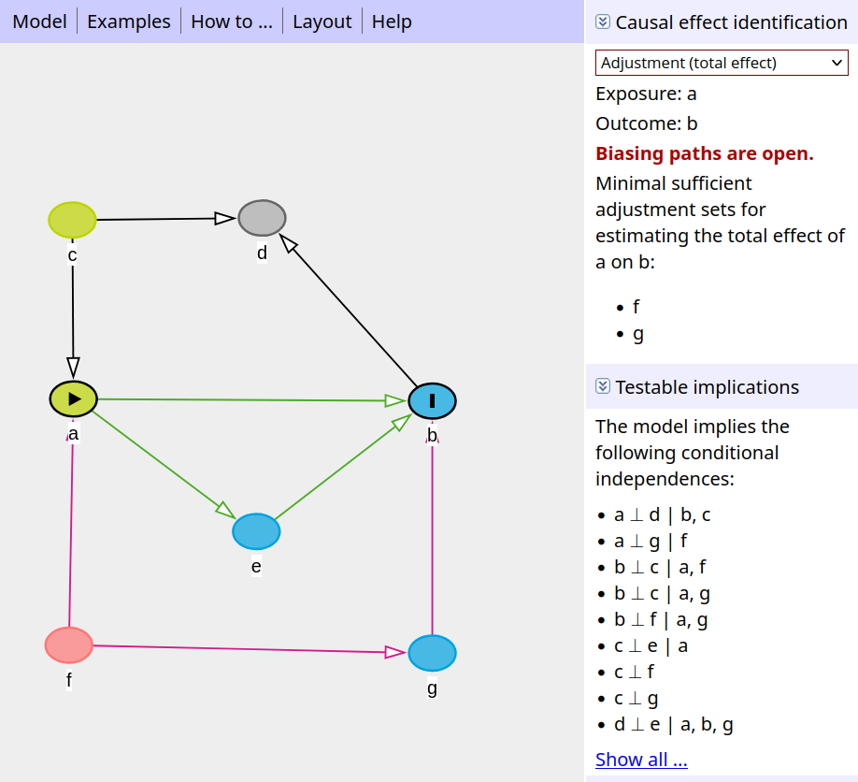
A guides tour through DAGitty
DAGitty is a browser-based tool to create and analyse DAGs
It helps causal inference by automatically identifiying necessary adjustment sets.
Based on the graphical causal model, it provides conditional independence criteria that can be used to test models.
Access it here: https://dagitty.net/
Textor et al., Robust causal inference using directed acyclic graphs: the R package 'dagitty'. International Journal of Epidemiology 45(6):1887-1894, 2016.

Slide 4
Live Demo
Exercises in DAGitty
4

Slide 5
Problem 1
Determine the adjustment set of variables to block any backdoor causal path for the estimation of the direct effect of a on b.
c
d
a
b

Slide 6
Problem 1 Solution https://dagitty.net/mDymjnHV9
Determine the adjustment set of variables to block any backdoor causal path for the estimation of the direct effect of a on b.
c
d
c
d
a
b
a
b
Adjustment set = {c}
Adjustment set = {d}

Slide 7
Problem 2
Determine the adjustment set of variables to block any backdoor causal path for the estimation of the direct effect of a on b.
c
e
d
a
b

Slide 8
Problem 2 Solution https://dagitty.net/mPxsokVRw
Determine the adjustment set of variables to block any backdoor causal path for the estimation of the direct effect of a on b.
c
e
d
a
b
Adjustment set = {}

Slide 9
Problem 3
Determine the adjustment set of variables to block any backdoor causal path for the estimation of the direct effect of a on b.
c
e
d
a
b

Slide 10
Problem 3 Solution https://dagitty.net/mvzunz7xx
Determine the adjustment set of variables to block any backdoor causal path for the estimation of the direct effect of a on b.
c
e
d
a
b
Adjustment set = {e}

Slide 11
Problem 3 more interesting
Determine the adjustment set of variables to block any backdoor causal path for the estimation of the direct effect of a on b.
c
e
c
e
d
d
a
b
a
b
Adjustment set = {e}

Slide 12
Problem 3 Solution https://dagitty.net/m7RVrEEnA
Determine the adjustment set of variables to block any backdoor causal path for the estimation of the direct effect of a on b.
c
e
c
e
d
d
a
b
a
b
Adjustment set = {e}
Adjustment set = {c,d}

Slide 13
Problem 4: Does an automated testing framework (X) reduce post-relase defects (Y)?
A software quality team studies the effect of the introduction of an automated testing framework on post-relase defects of a large system. They know:
Experienced developers are more likely to adopt the framework and to write less defect-prone code.
The framework lowers defects directly, and also by raising test coverage.
More complex modules tend to have more post-release defects.
Both the framework and module complexity raise the number of issues logged.
Draw a DAG including the variables: Autom. Testing, Post-Release Defects, Developer Experience, Test Coverage, Logged Issues, Code Complexity.
Identify:
Which variables are confounders;
Which are mediators;
What is the minimal adjustment set to estimate the direct and total effect of automated testing on post-release defects.

Slide 14
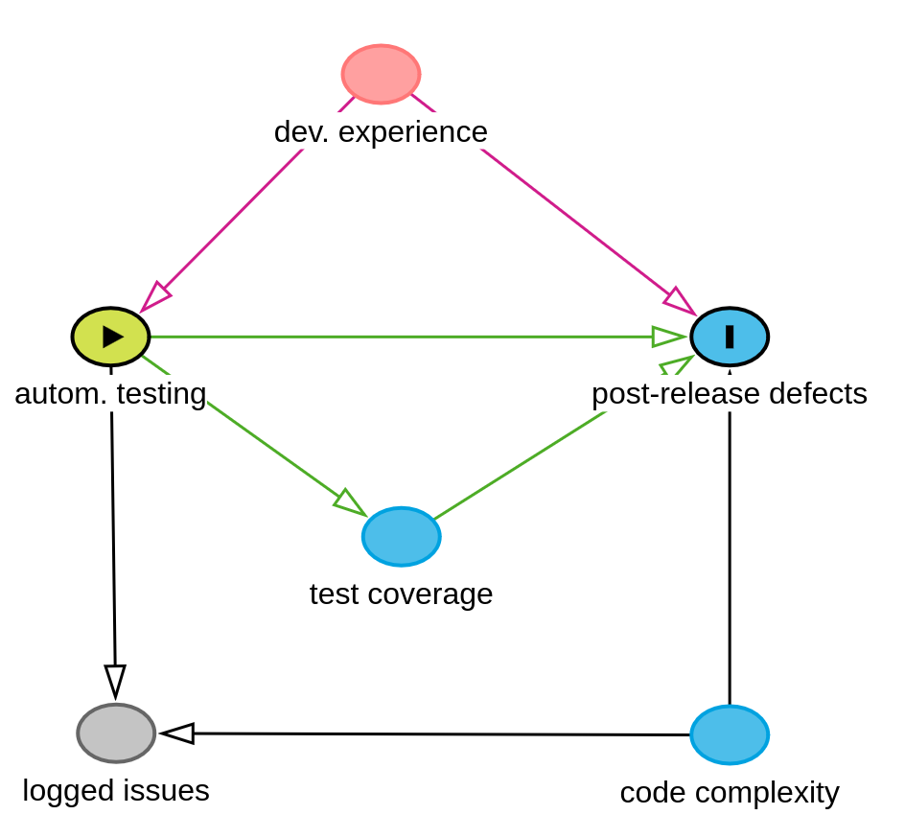
Problem 4: Solution https://dagitty.net/mFcJtc32s
A software quality team studies the effect of the introduction of an automated testing framework on post-relase defects of a large system. They know:
Experienced developers are more likely to adopt the framework and to write less defect-prone code.
The framework lowers defects directly, and also by raising test coverage.
More complex modules tend to have more post-release defects.
Both the framework and module complexity raise the number of issues logged.

